Slide 1
PowerPoint 2:
Rights and Responsibilities in a Democracy

Slide 2
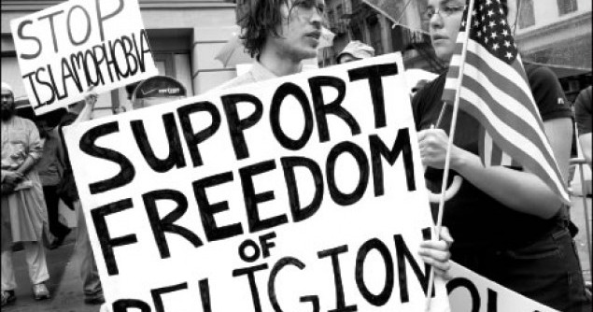
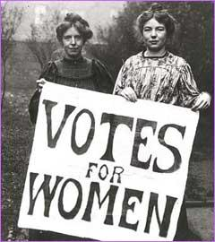
What is a right?
In Canada and other democracies, citizens have certain rights.
A right is a privilege or freedom that is protected.
Rights are not usually provided automatically; they are usually fought for and claimed.
Example: Every child has the right to learn (UN Convention on the Rights of the Child).

Slide 3
Discussion
Can you think of any rights you have at home or at school?
Have you ever had to fight for any rights or argue for any privileges?

Slide 4
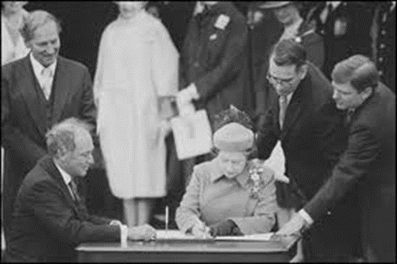
Rights and Freedoms in Canada
In Canada, citizens’ rights and freedoms are protected by the Canadian Charter of Rights and Freedoms, a part of the Constitution Act that was signed by Queen Elizabeth II in 1982.

Slide 5
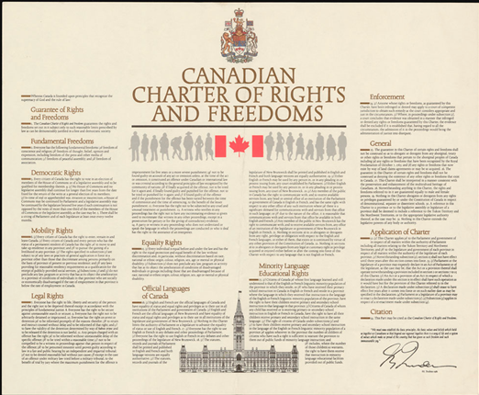
Seven Sections of the Charter
The Canadian Charter of Rights and Freedoms has seven sections that define our rights as Canadians:
Fundamental (or basic) freedoms
Democratic rights
Mobility rights
Legal rights
Equality rights
Official languages of Canada
Minority language education rights

Slide 6
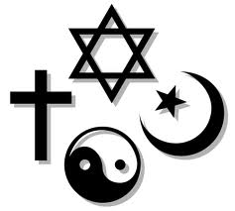
Fundamental Freedoms (Basic Rights)
The right to worship your god or no god (freedom of religion)
The right to form your own opinion (freedom of thought)
The right to share your opinions (freedom of expression)
The freedom of the media to report on all matters and events
The right to join or leave groups (freedom of association)
The right to gather and protest (freedom of peaceful assembly)

Slide 7
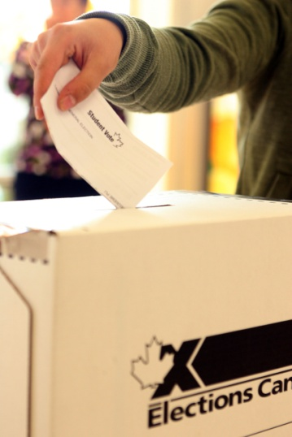
Our Democratic Process
There are too many people in Canada for everyone to have a say in every political decision, so we vote for representatives to make decisions and pass laws on our behalf. This is called a representative democracy.
Elections are the processes by which those elected representatives are chosen.

Slide 8
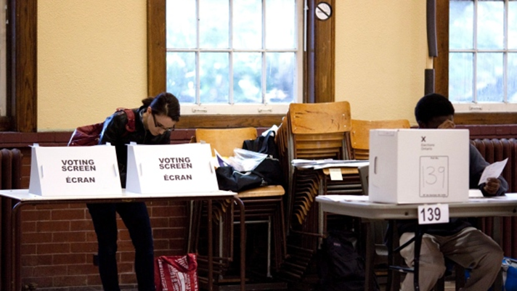
Our Democratic Rights
Every Canadian citizen, 18 years and older, has the right to vote in a Canadian election and to be a candidate in a Canadian election.
Our democratic rights also include the requirement of the federal government to hold an election at least every five years.

Slide 9
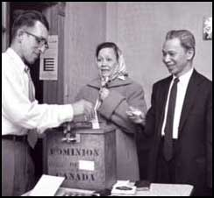
The Right to Vote
The right to vote has been fought for by various groups throughout our history.
Initially, only men who owned land or a house could vote.
After much protest by men and women who thought this was unfair, women received the right to vote federally in 1918.
The last limitations for various ethnic groups and religious groups were not removed until 1960.
Universal suffrage is the expansion of the right to vote to all adult citizens.

Slide 10
What is a responsibility?
A responsibility is a duty or obligation.
It is something you should do to show that you respect your rights.
Example: Your right to an education comes with the responsibility to show up to school prepared and on time.

Slide 11
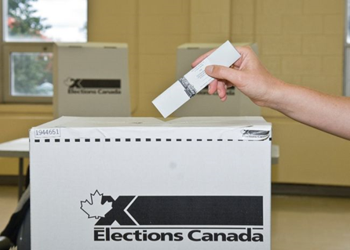
Responsibilities in a Democracy
It is the responsibility of all Canadians to respect and follow the rules set out in the Constitution.
The right to vote comes with the responsibility to vote and to make an informed decision.

Slide 12
Federal Voter Turnout
Year | Voter Turnout
2011 | 61.1%
2008 | 58.8%
2006 | 64.7%
2004 | 60.9%
2000 | 61.2%
1997 | 67.0%

Slide 13
Final Thoughts
How important is it that individuals behave as responsible members of society? Why?
Will you vote when you turn 18?
Should voters lose the right to vote if they choose to ignore their duty to vote in an election?

