Slide 1
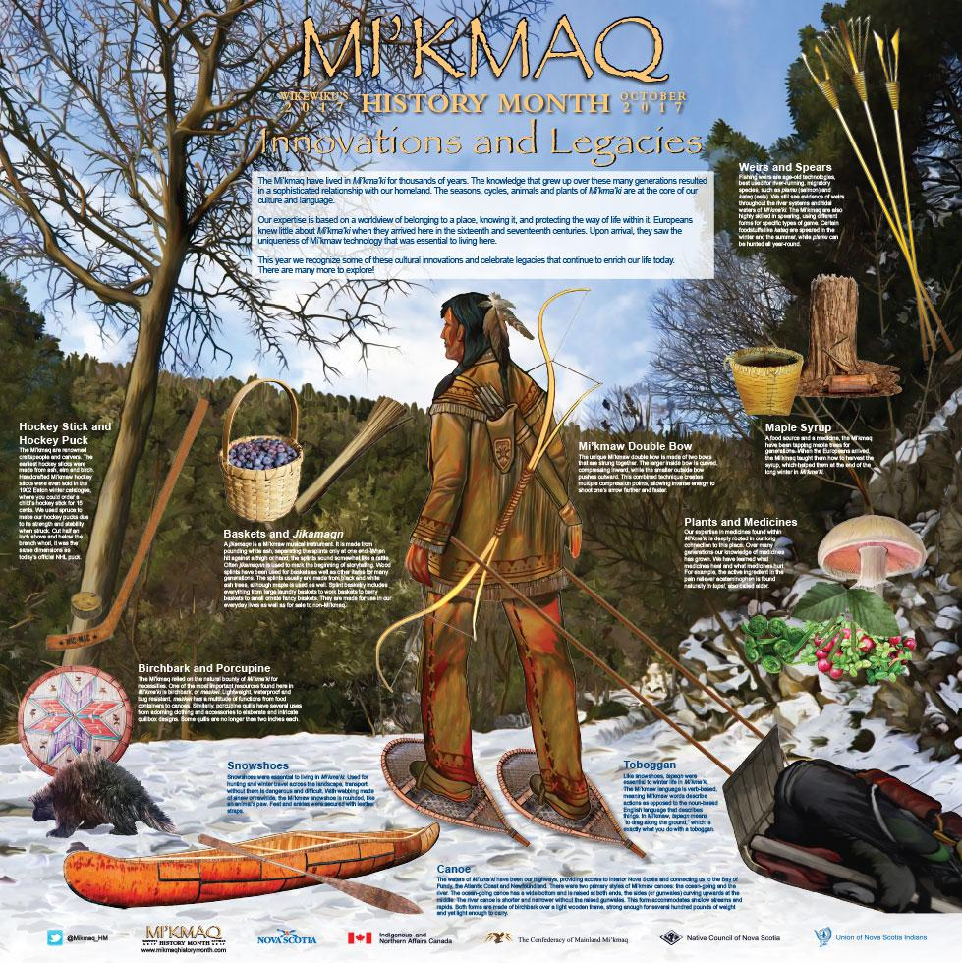

Slide 2
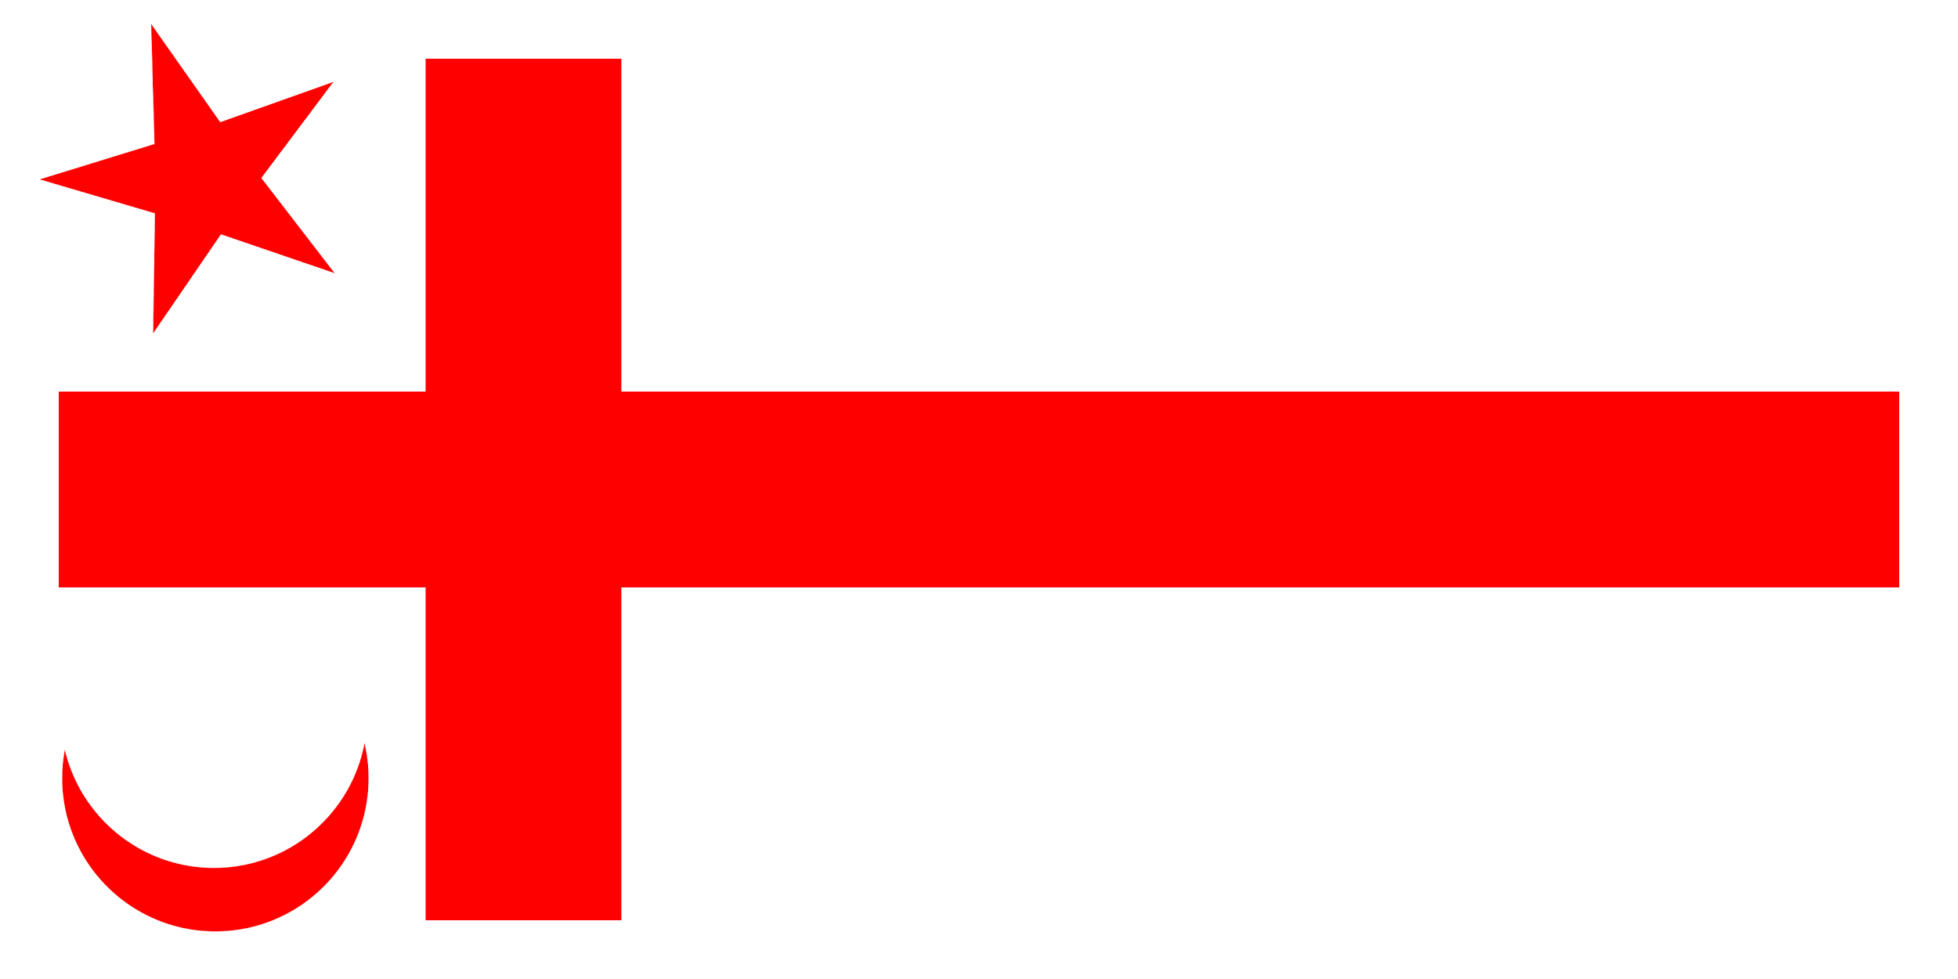
Mi’kmaq History Month
October 2017
Innovation and Legacy
Back to the Poster

Slide 3
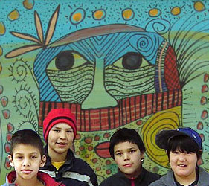
Innovation and Legacy
The Mi’kmaq have lived in Mi’kma’ki for thousands of years. The knowledge that grew over these generations resulted in sophisticated relationships with our homeland. The seasons, cycles, animals and plants of the Mi’kma’ki are at the core of our culture and language.
Back to the Poster

Slide 4
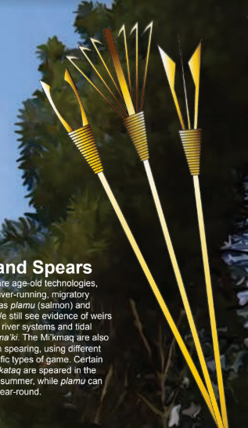
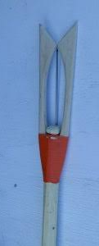
Weirs and Spears
Fishing weirs are age old technology best used for river running, migratory species, such as plamu (salmon) and kataq (eels). We still see evidence of weirs throughout the river system and tidal waters of Mi’kma’ki. The Mi’kmaq are also highly skilled in spearing, using different forms for specific type of game. Certain foodstuffs like kataq are speared in the winter and the summer, while plamu can be hunted year-round.
Back to the Poster

Slide 5
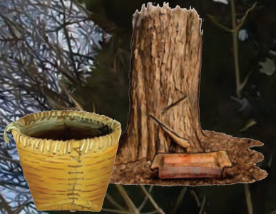
Maple Syrup
A food source and medicine. The Mi’kmaq have been tapping maple trees for generations. When the Europeans arrived the Mi’kmaq taught them how to harvest the syrup, which helped them at the end of a long winter in Mi’kma’ki.
Back to the Poster

Slide 6
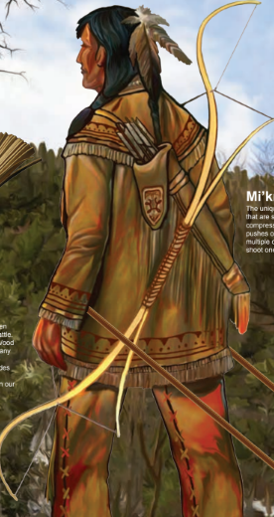
Mi’kmaw Double Bow
The unique Mi’kmaw double bow is made of two bows that are strung together. The larger bow is curved compressing inward, while the smaller outside bow pushes outward. This combined technique creates multiple compression points, allowing intense energy to shoot one’s arrow farther and faster.
Back to the Poster

Slide 7
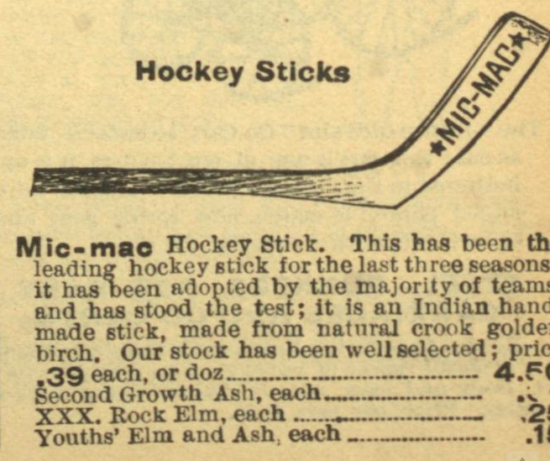
Hockey Stick and Puck
The Mi’kmaq are renowned craftspeople and carvers. The earliest hockey sticks were made from ash, elm and birch. Handcrafted Mi’kmaq hockey sticks were even sold in the 1902 Eaton winter catalogue, where you could order a child’s hockey stick for 15 cents. We used spruce to make our hockey pucks due to its strength and stability when struck. Cut half an inch above and below the branch whorl, it was the same dimensions as today’s official NHL puck.
Back to the Poster

Slide 8
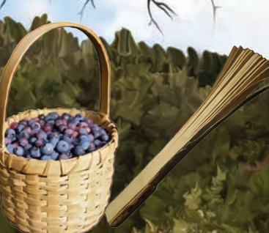
Baskets and Jikamaqn
A jikamaqn is a Mi’kmaw musical instrument. It is made from pounding white ash, separating the splints only at one end. When hit against the thigh or hand the splints somewhat like a rattle. Often jikamaqnn is used to mark the beginning of storytelling. Wood splints have been used for baskets as well as other items for many generations. The splints are usually made from black and white ash trees, although maple is used as well. Splint basketry includes everything from large laundry baskets to work baskets to berry baskets to small ornate fancy baskets. They are made for use in our everyday lives as well as for sale to non-Mi’kmaq.
Back to the Poster

Slide 9
Birchbark and porcupine
The Mi’kmaq relied on the natural bounty of Mi’kma’ki for necessities. One of the most important resources found here in Mi’kma’ki is birchbark or maskwi. Lightweight, waterproof and bug resistant, maskwi has a multitude of functions from food containers to canoes. Similarly, porcupine quills have several uses from adorning clothing and accessories to elaborate and intricate quillbox designs. Some quills are no longer than two inches long each.
Back to the Poster

Slide 10
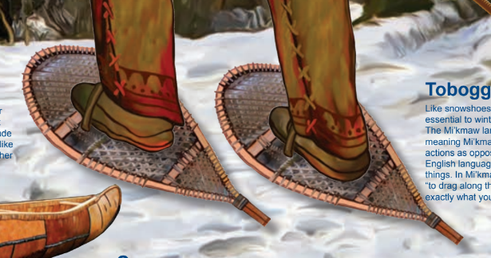
Snowshoes
Snowshoes were essential to living in Mi’kma’ki. Used for hunting and winter travel across the landscape, transport without them is dangerous and difficult. With webbing made of sinew or rawhide, the Mi’kmaw snowshoe is rounded, like an animal paw. Feet and ankles were secured with leather straps.
Back to the Poster

Slide 11
Canoe
The waters of Mi’kma’ki have been our highways, providing access to interior Nova Scotia and connecting us to the Bay of Fundy, the Atlantic coastline and Newfoundland. There were two primary styles of Mi’kmaw canoes: the ocean-going and the river. The ocean-going canoe has a wide bottom and is raised at both ends, the sides (or gunwales) curving upward at the middle. The river canoe is shorter and narrower without the raised gunwales. This form accommodates shallow streams and rapids. Both forms are made of birchbark over a light wood frame, strong enough for several hundred pounds of weight yet light enough to carry.
Back to the Poster

Slide 12
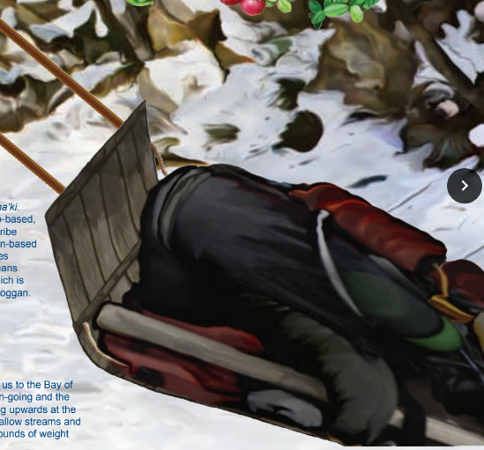
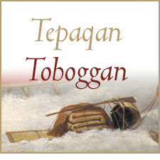
Toboggan
Like snowshoes, tapaqn were essential to winter life in Mi’kma’ki. The Mi’kmaw language is verb based meaning Mi’kmaw words describe actions as opposed to the noun based English language that describe things. In Mi’kmaw, tapaqn means “to drag along the ground.” which is exactly what you do with a toboggan.
Back to the Poster

Slide 13
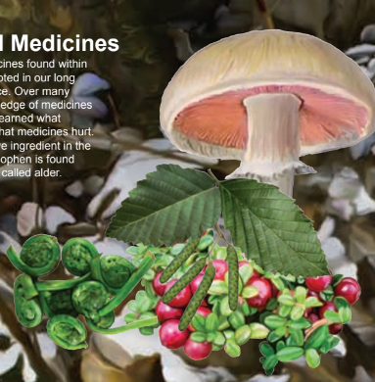
Plants and Medicines
Our expertise in medicines found within Mi’kma’ki is deeply rooted in our long connection to this place.
Over many many generations our knowledge of medicines has grown. We have learned what medicines leal and what medicines hurt. For example, the active ingredient in the pain reliever acetaminophen is found naturally in tupsi, also called alder.
Back to the Poster

Slide 14
Mi’kmaq History Month
Back to the Poster

